Slide 1
Chapter 1
Introduction to software Engineering

Slide 2
Software
Many of us equate software with program.
Software is not just the program .
Softwrare is a set of instructions that enable computer to perform specified task.
More precisely,Software is program, all associated documentation and configuration data needed to make program operate correctly.

Slide 3
1. Definition of Software Engineering
Software is a program or set of programs containing instructions that provide desired functionality.
Engineering is the process of designing and building something that serves a particular purpose and finds a cost-effective solution to problems.
Software Engineering is a systematic, disciplined, quantifiable study and approach to the design, development, operation, and maintenance of a software system.

Slide 4
2. Evolving Role of Software
Software is a product
Delivers the computing potential
Enables the Hardware to deliver the expected functionality.
Produces, manages, acquires, modifies, displays, or transmits information.

Slide 5
Conti..
As a vehicle for delivering a product
It provides system functionality (e.g., payroll system)
It controls other software (e.g., an operating system)
It helps build other software (e.g., software tools)
Effects communication (e.g., Networking software)

Slide 6
Program Versus software
A program is a set of instructions that are given to a computer in order to achieve a specific task whereas software is when a program is made available for commercial business and is properly documented along with its licensing.Software= Program+ documentation + licensing.
A program is one of the stages involved in the development of the software, whereas a software development usually follows a life cycle, which involves the feasibility study of the project, requirement gathering, development of a prototype, system design, coding, and testing.

Slide 7
3. Changing Nature of software
System Software
Application Software
Engineering and Scientific Software
Embedded Software
Product Line Software
Web Application Software
Artificial Intelligence Software

Slide 8
3. Changing Nature of software
Seven broad categories of computer software present continuing challenges for software engineers
System Software:
Collection of programs which are written to service other programs.
Processes complex but determinate, information structures.
Other system application process largely indeterminate data.
System software area is characterized by the heavy interaction with computer hardware that requires scheduling, resource sharing, and sophisticated process management.

Slide 9
3. Changing Nature of software
Application Software:
Programs that solve a specific business need.
Process business or technical data that facilitates business operation or management technical decision making.
Used to control business function in real time.

Slide 10
3. Changing Nature of software
Engineering and Scientific Software
Facilitate the engineering function and task.
Engineering and scientific area are moving away from the conventional numerical algorithms.
Computer-aided design, system simulation, and other interactive applications have begun to take a real-time.

Slide 11
3. Changing Nature of software
Embedded Software:
Embedded software resides within the system or product
Used to implement and control feature and function for the end-user and for the system itself.
Embedded software can perform the limited and esoteric function

Slide 12
3. Changing Nature of software
Artificial Intelligence Software:
Artificial intelligence software makes use of a non numerical algorithm to solve a complex problem
Application within this area includes robotics, expert system, pattern recognition, artificial neural network, theorem proving and game playing

Slide 13
3. Changing Nature of software
Product-line Software:
Designed to provide a specific capability for use by many different customers, product line software can focus on the limited and esoteric marketplace or address the mass consumer market.

Slide 14
3. Changing Nature of software
Web Application:
It is a client-server computer program which the client runs on the web browser.
Web apps can be little more than a set of linked hypertext files that present information using text and limited graphics.
However, as e-commerce and B2B application grow in importance.
Web apps are evolving into a sophisticate computing environment that not only provides a standalone feature, computing function, and content to the end user.

Slide 15
Software Evolution
1945- 1965 – Origin
1965- 1985- software crisis
1990- 2000- internet
2000-2010- Light weight
2010- till –AI, ML,DL

Slide 16
Characteristics of software
Software is developed or engineered it is not manufactured
Software development present s a job-shop environment
Time and effort for software development are hard to estimate
Software does not wear out
Testing software is extremely difficult
Difficult to measure the progress of software development
User requirement are often not conceived well, so undergo many modifications before implemented.
Software directly depends upon the hardware

Slide 17
Software is developed or engineered it is not manufactured
No concept of raw material
Better visualized as process rather than product
Human element is high compared to manufacturing
Development productivity is highly uncertain, even with standard products, varying greatly with skill of developer.
Development tools, technique, standards and procedure vary widely.
Quality problem in software development are different from that of manufacturing.
Difficult to measure quality compared to manufacturing.

Slide 18
Software development present s a job-shop environment
Each product is custom built so unique
Cannot be assembled from existing components
The problem of design, estimating and scheduling are present
Human skill is main component in software development

Slide 19
Time and effort for software development are hard to estimate
Interesting work gets done at the expense of dull work.
Documentation being dull work gets less priority.
Job should be done in clever way rather than doing adequately, on time and reasonable cost.
Programmer tend to be optimistic , not realistic
Time estimation for task completion reflect this tendency
Programmers have trouble communicating.

Slide 20
Software does not wear out
Software does not loose its functionality with use.
It may loose its functionality in time, however as the requirements change.
When defects are encountered, they are removed by rewriting the relevant code not by replacing with available code.
There is no concept of replacing the code by spare code in software development.
When defects are removed ,there is likelihood that new defects are introduced.

Slide 22
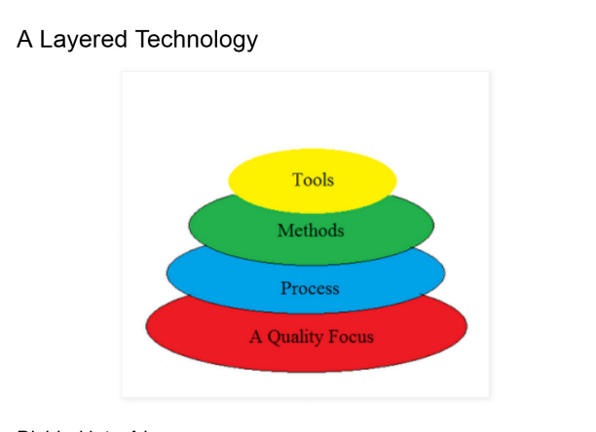
Software Engineering Layered Technology

Slide 23
Software Engineering Layered Technology
Software engineering is a fully layered technology,
To develop software we need to go from one layer to another.
All the layers are connected and each layer demands the fulfillment of the previous layer.
Layered technology is divided into four parts

Slide 24
Software Engineering Layered Technology
1. A quality focus
Degree of goodness
Correctness
Maintainability
Usability
Bed rock of any product

Slide 25
Software Engineering Layered Technology
2. Process:
What to do?
It is the foundation or base layer of software engineering.
Binds all the layers together which enables the development of software before the deadline or on time.
Process defines a framework that must be established for the effective delivery of software engineering technology.
The software process covers all the activities, actions, and tasks required to be carried out for software development.

Slide 26
Software Engineering Layered Technology
Process activities are listed below:-
Communication: It is the first and foremost thing for the development of software. Communication is necessary to know the actual demand of the client.
Planning: It basically means drawing a map for reduced the complication of development.
Modeling: In this process, a model is created according to the client for better understanding.
Construction: It includes the coding and testing of the problem.
Deployment:- It includes the delivery of software to the client for evaluation and feedback.

Slide 27
Software Engineering Layered Technology
3. Method
During the process of software development the answers to all “how-to-do” questions are given by method.
It has the information of all the tasks which includes communication, requirement analysis, design modeling, program construction, testing, and support.

Slide 28
Software Engineering Layered Technology
4. Tools
Software engineering tools provide a self-operating system for processes and methods.
Tools are integrated which means information created by one tool can be used by another.

Slide 29
Software Crisis
Difficulty of writing useful and efficient computer programs in the required time.
The software crisis occurs due to using the same workforce, same methods, and same tools even though rapidly increasing software demand, the complexity of software, and software challenges.
With the increase in software complexity, many software problems arise because existing methods were insufficient.

Slide 30
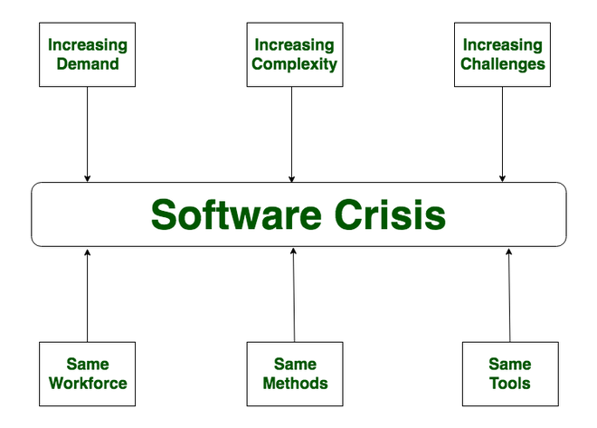
Software Crisis

Slide 31
Factors Contributing to Software Crisis
Poor project management.
Lack of adequate training in software engineering.
Less skilled project members.
Low productivity improvements.

Slide 32
Solution of Software Crisis
Reduction in software budget.
The quality of the software must be high.
Less time is needed for a software project development.
Experienced and skilled people working on the software project.
Software must be delivered.
Software must meet user requirements.

Slide 33
Tutorial 1
Differentiate between software and program.
Define software. Discuss the types of software.
What is software engineering?
Discuss characteristics of software
“Software does not wear out” justify the statement.
Discuss the layered technology approach of software engineering.

